Slide 1
QSYS – Pipping Pressure Overview
Daniel Berkowitz (ATS/ACR)

Slide 2
QSYS – System Breakdown
Cryoplant & Infrastructure
WCS
QRB
WSH
WSH
WSH
WPS
Cryo Backbone
QLM
QVB
QVB
QVE
Cryomodules
QM
QM
QCELL

Slide 3
title

Slide 4
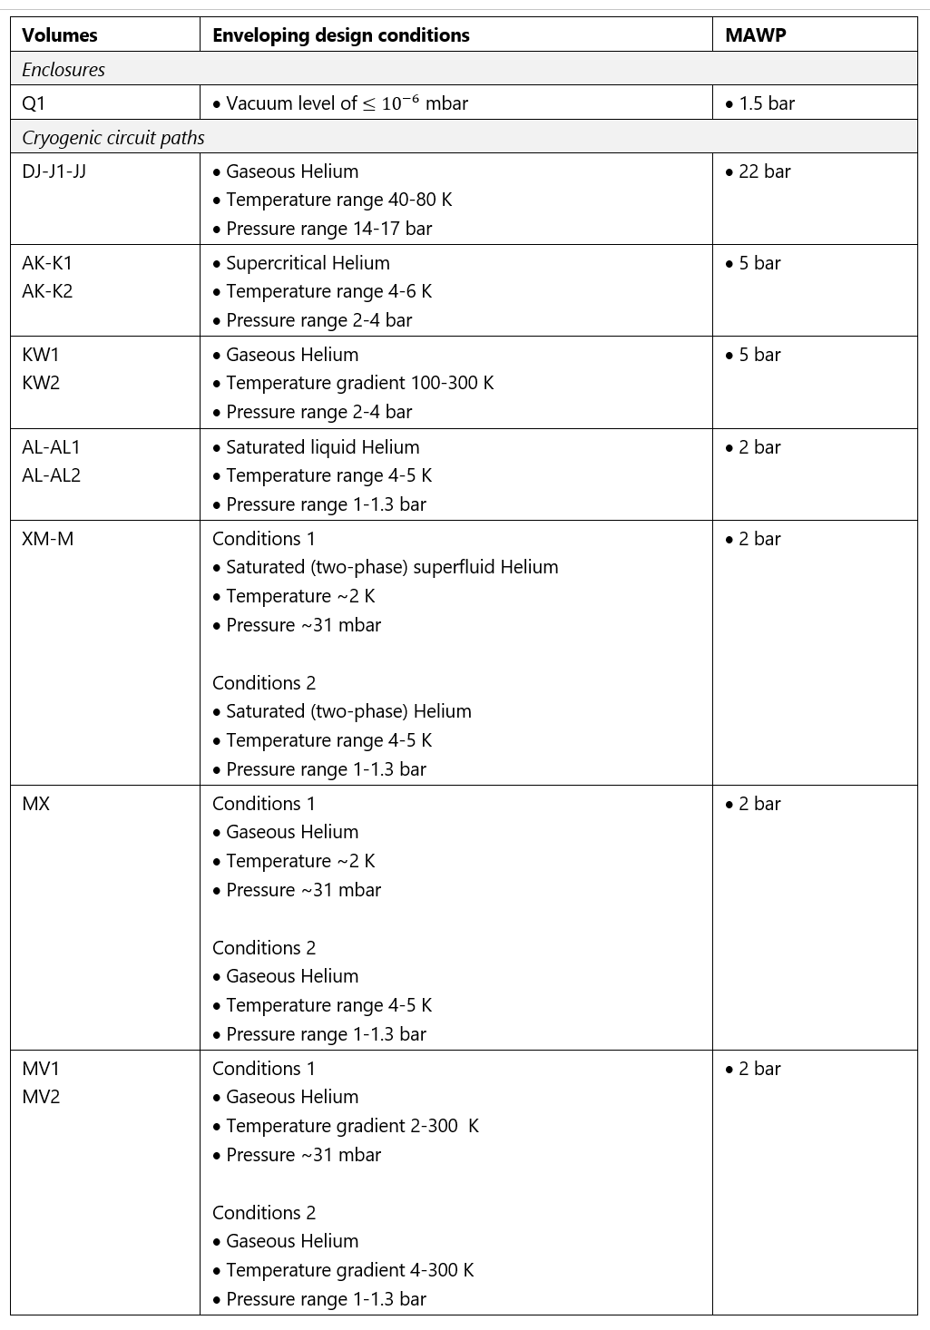
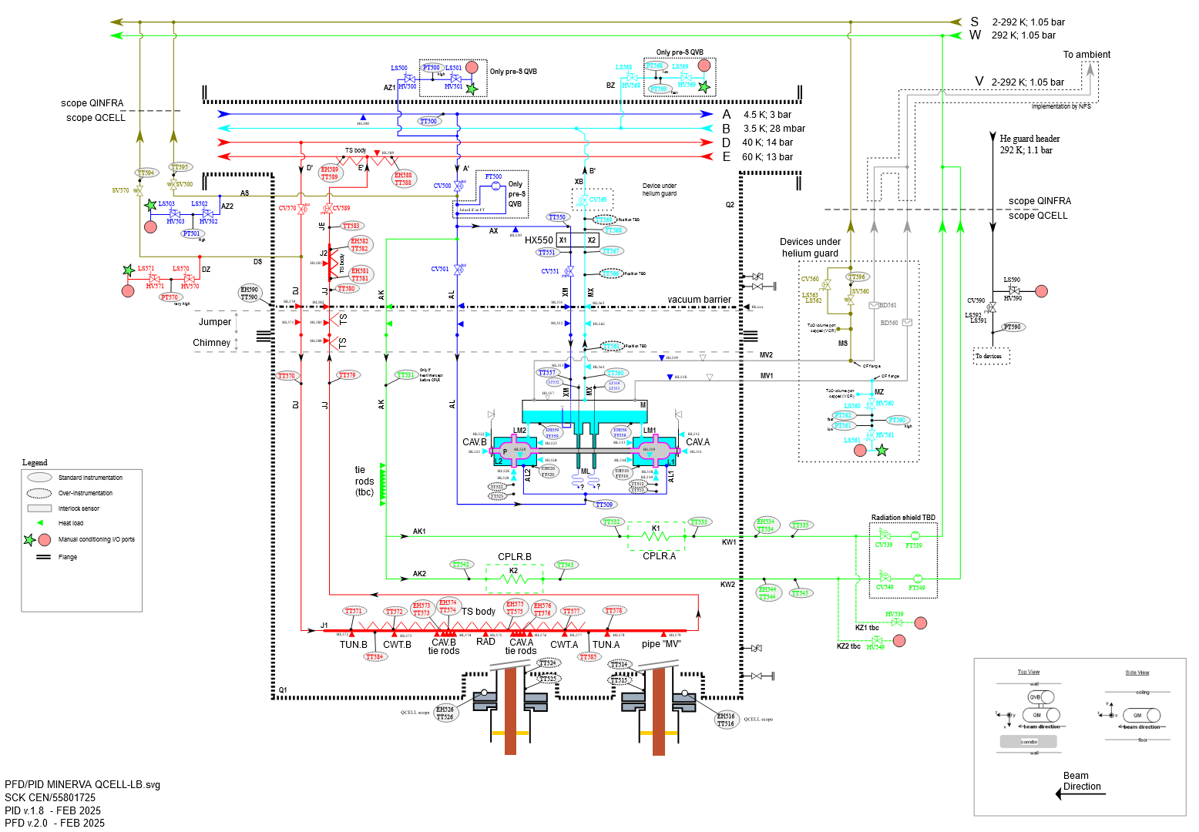
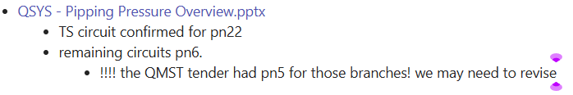
22/MAY-2025
From QDB:
TS circuit confirmed for pn22
remaining circuits pn6.
!!!! the QMST tender had pn5 for those branches! we may need to revise
QCELL – Pipping Pressure
QMST Specs – ALX/43737760
Too low!!!
Values to be challenged.
Only “L” is pn2
43737760

Slide 5
QCELL – Pipping Pressure
Q2
Q1

Slide 6
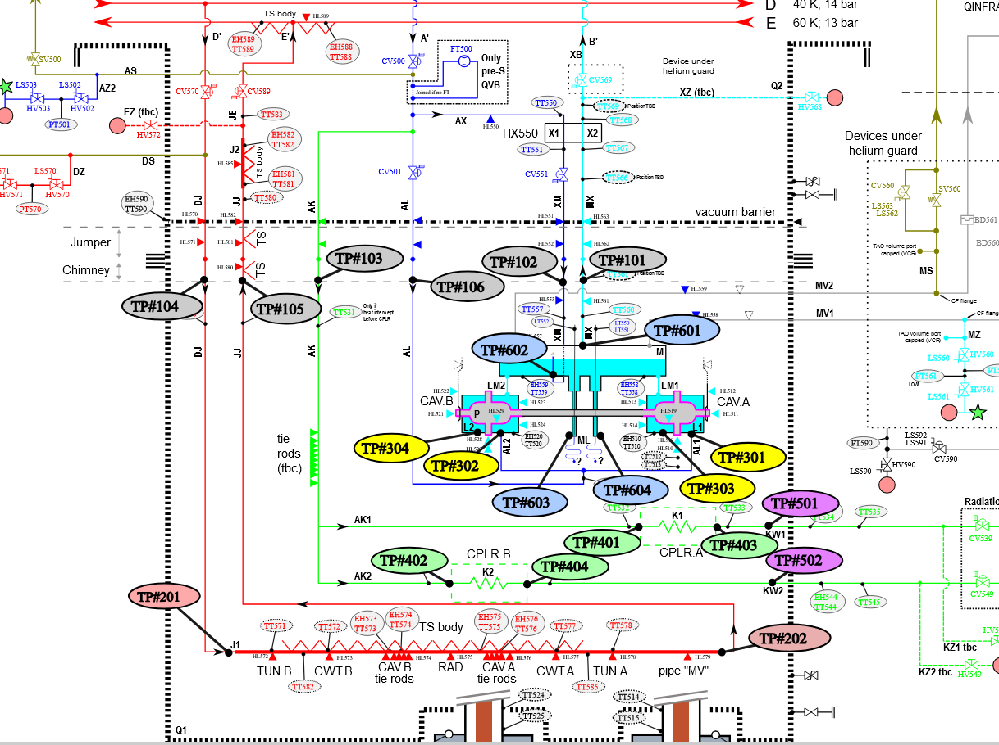
QCELL – Pipping Pressure
M
M
M
P
L1
L2
Q1

Slide 7
QCELL – Pipping Pressure
Terminology
P = BVAC volume, corresponds to P1 & P2 for each cavity
L = Helium bath volume, corresponds to L1 & L2 for each cavity
Q = INVAC volume, corresponds to Q1 for the QM
Z = Ambient
Z
Q
3
L
2
P
1
Footnote
2b, L: Capped by CV560
3a/b, L: Capped by BD560&1
3b, Q: Capped by INVACs BD
4
5

Slide 8
Copyright © SCK CEN
All property rights and copyright are reserved.
This presentation contains data, information and formats for dedicated use only and may not be communicated, copied, reproduced, distributed or cited without the explicit written permission of SCK CEN.
If this explicit written permission has been obtained, please reference the author, followed by ‘by courtesy of SCK CEN’.
Any infringement to this rule is illegal and entitles to claim damages from the infringer, without prejudice to any other right in case of granting a patent or registration in the field of intellectual property.
SCK CEN
Belgian Nuclear Research Centre
Studiecentrum voor Kernenergie
Centre d'Etude de l'Energie Nucléaire
Foundation of Public Utility
Stichting van Openbaar Nut
Fondation d'Utilité Publique
Registered Office:
Avenue Herrmann-Debrouxlaan 40 - 1160 BRUSSELS - Belgium
Research Centres:
Boeretang 200 - 2400 MOL - Belgium
Chemin du Cyclotron 6 - 1348 Ottignies-Louvain-la-Neuve - Belgium

